Slide 1
DISTRIBUTIONS In Salesforce

Slide 2
Agenda
Creating Distributions
How do we Verify the participant?
Distribution Types Overview
Handling Distributions in Salesforce
Email Notifications Setup
QR Code Implementation
Highlight Panel for Status Tracking
Auto Case Number and List View
Questions and Discussion

Slide 3
Current Distribution Flow in PENSERV
Distribution forms are received via:
Mail
Fax
Email

Slide 4
Existing Functionality in Relius
Forms are scanned using outlook scanner
Some fields are captured like
First Name
SSN
Address
A record gets created in Dynamics
Last Name
Processing Unit Will start working on distribution record

Slide 5
Distribution Handling Methods
Method 1: Distribution CRM - Record keeper
Record Validation:
Processing unit validates the distribution record directly.
Assignment:
Records are assigned to respective teams based on the nature of the distribution.
Team Responsibilities:
Teams manage all distribution activities, including:
Communication with participants.
Coordination with vendors.
Ensuring compliance with all necessary regulations.
Completion:
Once all tasks are finalized, the distribution is marked as Completed.

Slide 6
Distribution Handling Methods
Method 2: Non-Custodian Handling
Approval notices are issued (as Penserv is not the custodian).
Processing Unit team verifies participant details:
If SSN is missing: The team retrieves the SSN from Relius and updates the record.
If other information is unclear or Missing then CSR Engagement:
CSR contacts the participant or employer to gather necessary information.
Final Verification:
Once all information is verified, the processing unit assesses the distribution request.
If the request is valid, an approval notice is sent to vendors.
The distribution record status is marked as Completed.

Slide 7
Distribution types
1.Termination
2.In-Service Distribution / Termination
3.Required Minimum Distribution (RMD)
4.Participant Loan (Non-Residential)
5.Withdrawal Of Rollover Account
6.Withdrawal Of Post-Tax Account
7.Purchase of Service Credits
8.Disability
9.Death Of Participant
10.Plan-To-Plan Transfer
11.Traditional Residential Loan (non-IRS1099)
12.Hardship
13.Transfer/Exchange: Plan-To-Plan (PTP) / Custodial

Slide 8
Election Types
A. Vested Rollover To Traditional Retirement Account
B. Vested Rollover To Roth Elective Deferral Account
C. Roth Account Rollover To Roth Account or Roth IRA
D. Partial Rollover To Qualified Plan or IRA w/Residual Lump-Sum
E. Vested Lump-Sum Payment
F. Vested Lump-Sum Portion
G. Distribution Installment Payments
H. Qualified Joint & Survivor Annuity (QJSA)
I. Roth In-Plan Conversion

Slide 9
Hardship
RMD
Loan
Termination
Transfer/Exchange
Death of participant

Slide 10
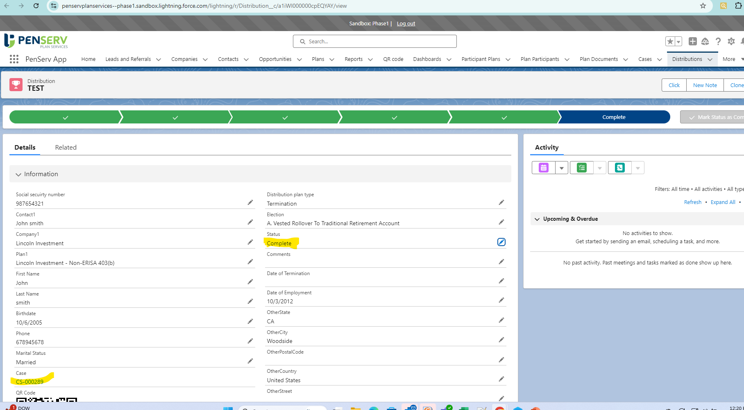
Highlight panel and Case Number

Slide 11
Next Steps for Distribution Implementation
1.Assigning Distribution Records
➔ Implement a routing system to assign each distribution record to the respective team.
2.Escalation Emails
➔ Set up automated escalation emails for distributions that remain unaddressed.
3.Activity Tracking System
➔ Develop a tracking system to log calls, faxes, emails, and mail correspondence.
➔ Maintain comprehensive activity history:
Capture how each distribution comes in.
Track how each distribution goes out.
4.Integration with Nintex Form.

Slide 12
5. Form Submission Restrictions –plan specs Implement system checks to reject duplicate distribution types begin created.
Setting up Age limits in plan specs
6. Approval Notices
Set up a process for generating approval notices for successful applications.
7. ACH Details Configuration Configure ACH routing information to facilitate direct deposits and payments.
8. Beneficiary Management Establish procedures for adding beneficiaries in the event of a participant's death during distribution.
9. Distribution Payment Configuration Configure options for Monthly Installment Payments for loans or hardships.

Slide 13
Any Questions?
Thank you
Pavithra Veeramani
5018172036
pveeramani@penserv.com​

